Slide 1
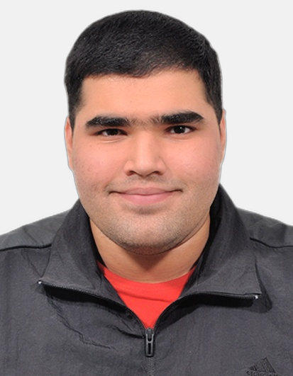
Chaitanya Sapra
Technical Consultant
Chaitanya is a highly driven tech enthusiast with a versatile skill set and a strong foundation in Machine Learning, MySQL, Java Spring Boot, and Web Development. He has hands-on experience building AI-powered projects and developing end-to-end web solutions, contributing to multiple projects across domains. He is passionate about learning, technology, and innovative problem-solving, and is eager to apply his knowledge to real-world challenges to drive meaningful change. He also has exposure to multi-layered application architectures, data processing and analysis, and the implementation of intelligent automation solutions.
Industries and Domain
Computer Science & Engineering
Artificial Intelligence & Machine Learning
Experience Summary
Projects
Contributed to the design and development of AI-powered applications, leveraging Machine Learning and Deep Learning techniques to solve real-world problems across healthcare, education, and analytics domains.
Developed E.Y.E (Ethogram Yielding Engine), an AI-based system for automated animal behavior analysis using video processing, object tracking, and action classification.
Designed and implemented CoeusQuest, a scalable web-based examination platform enabling online assessments, result storage, and admin-level customization for global learning environments.
Built Cure-AI, an AI-driven healthcare assistance system that generates intelligent responses based on user inputs to provide basic health guidance using Machine Learning and NLP techniques.
Developed Car-Cave, a machine learning-based car price prediction web application using regression models and user-input driven analytics.
Worked with structured and unstructured data, performing data preprocessing, analysis, and visualization using Python libraries such as NumPy, Pandas, and Matplotlib.
Implemented end-to-end web solutions, including backend logic, data handling, and frontend integration for multiple projects.
Functional Competencies
Participated in project planning and estimation activities, contributing to solution design and implementation approaches.
Communicated progress, challenges, and outcomes effectively, demonstrating strong written and verbal communication skills.
Worked closely with cross-functional technical teams to deliver AI-driven and software-based solutions aligned with project goals.
Exhibited adaptability and a strong learning mindset, quickly acquiring new technologies and applying them to practical use cases.
Demonstrated strong analytical and problem-solving skills while debugging, optimizing, and enhancing application performance.
Maintained adherence to coding standards, documentation practices, and quality expectations throughout project execution.
Technical Skills
Java (Spring Boot),
MySQl
ML and AI
HTML, CSS and Java Script
Git
Data Science
React.js
Education and Certifications
B.E in Computer Science & Engineering (AI Specialization) - Chitkara University
Business Intelligence (BI) Essentials - IBM
Generative AI for Business Intelligence Analysts - IBM
Location: Bangalore
Notes:
Profile 3

